Slide 1
Spring Boot
Final Project – Bakery Store
Submission by Naheed Ahmad
Dated 9-3-24

Slide 2
What's in this presentation?
Final project – schema: bakery_store
Steps listed to organize and build the project

Slide 3
About the project
The MVP project has 4 tables
The 4th table is a join table
Bakery Store (Parent)
One to many
Many to many
Employee (Child)
Menu Item (Category or Type)

Slide 4
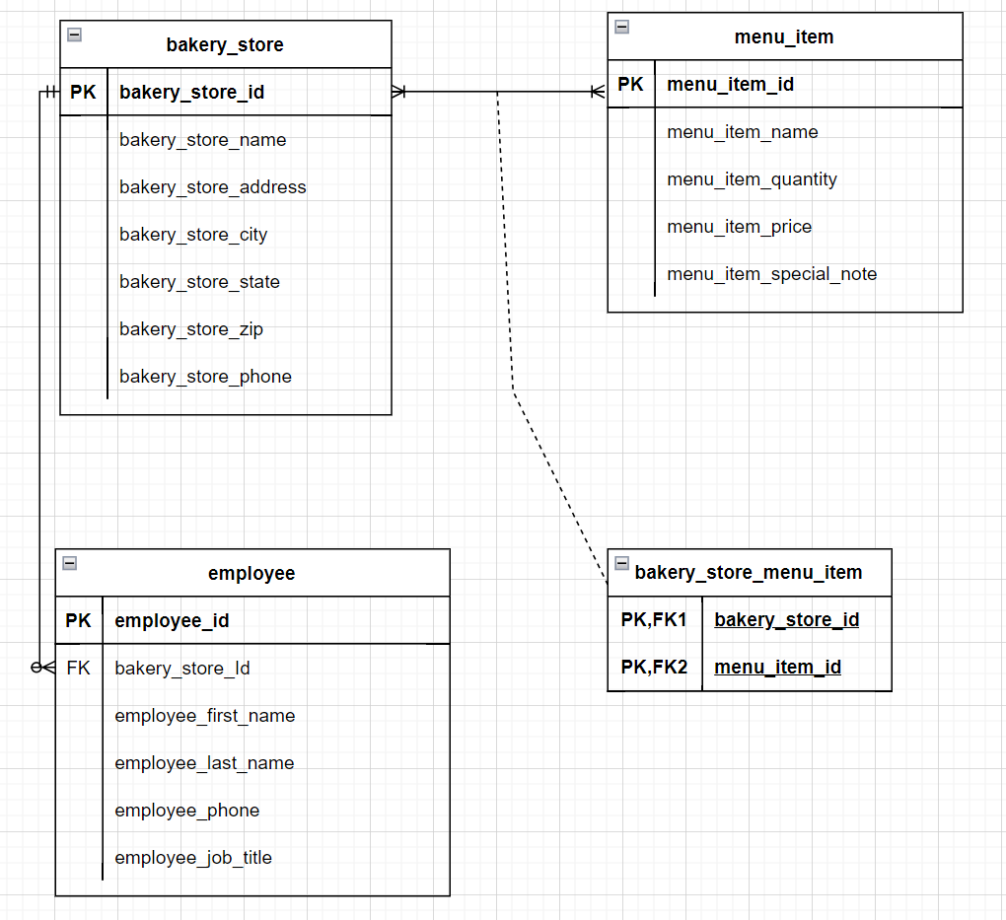
Entity Relationship Diagram – ERD for Bakery Store

Slide 5
Archive

Slide 6
Design steps
COMPLETED
Pick a project to model
Create an Entity-Relationship Diagram (ERD)
Verify these relationships:
One-to-many
Many-to-many
Double-check to ensure it makes sense and that you understand it

Slide 7
Structural steps
COMPLETED
Created schema, user, password, and permissions in MySQL Workbench
Refreshed the connection with DBeaver
Created a Maven project and titled it as Bakery-Store

Slide 8
Build steps – if using another project as a template
COMPLETED
Change the entities to match your design
Change the login info in application.yaml
Delete all but one DAO class and refactor it to fit your project
Add methods for the first operation in the controller and service classes
Verify that it works
Add other operations

Slide 9
Project requirements
COMPLETED
Must use Spring JPA for persistence layer
Must have at least one of each:
One-to-many relationship
Many-to-many relationship
Must perform all CRUD operations on a single entity
CRUD can be performed on bakery store and employee. Only delete and add new can be performed on Menu Item
Demonstrate adding and deleting rows in the join table (many-to-many relationship)

Slide 10

Project requirements
Must have fun!
Notes:
Downloaded from http://clipart-library.com/clipart/2072966.htm: free for personal use

